Slide 1
Data Analysis Review

Slide 2
What is NumPy used for?

Slide 3
What is NumPy used for?
NumPy (numpy) is primarily used for performing mathematical operations in Python in a computationally efficient way. Large data transforms using ndarrays, high level mathematical operations (linear algebra, matrices, fourier transforms, etc), cleaning data, and scientific computation are all areas of use for the library. NumPy is often used in conjunction with pandas, matplotlib, and other libraries to assist in efficient processing of data.

Slide 4
What is NumPy's most commonly used data structure?

Slide 5
What is NumPy's most commonly used data structure?
ndarray, a multi-dimensional (n) sized array

Slide 6
What’s the difference between a Python list and a NumPy array?

Slide 7
What’s the difference between a Python list and a NumPy array?
NumPy arrays are generally homogeneous meaning they contain all the same data type, usually a numeric or boolean. Python lists are heterogenous meaning they can contain several different types of data.
Operations on numpy arrays are far more efficient (in terms of speed and size) because they use less memory. Numpy uses contiguous memory which leads to faster computation.

Slide 8
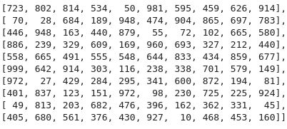
How would I find the maximum value in this ndarray named filedata?

Slide 9
How would I find the maximum value in this ndarray named filedata?
np.max(filedata)

Slide 10
Given this ndarray named filedata, how would I efficiently grab these values?

Slide 11
Given this ndarray named filedata, how would I efficiently grab these values?
center_array = filedata[4:6, 4:6]
Slicing

Slide 12
Given the following array named filedata, how would I filter for only those entries that are divisible by 3 and 5? What values are there in the result?

Slide 13
Given the following ndarray named filedata, how would I filter for only those entries that are divisible by 3 and 5? What values are there in the result?
filedata[(filedata %3==0) & (filedata%5==0)]
[960, 555, 600, 225, 45, 405]

Slide 14
What is pandas?

Slide 15
What is pandas?
The pandas Python library allows you to use efficient, high-performance data structures such as dataframes and series (basically labelled ndarrays) to work with structured data.

Slide 16
What is a pandas dataframe?
A Pandas DataFrame is a two-dimensional labeled data structure resembling a table with rows and columns, consisting of multiple series.

Slide 17
What is the difference between .loc and .iloc?

Slide 18
What is the difference between .loc and .iloc?
.loc() is label based. We can reference a row by its index value or column name. Generally, if we feed a number into .loc() it is interpreted as an index value (row identifier)
Example from our cleaning exercise: df.loc[218] # References the row in our table with the index value = 218. Place of Publication London Date of Publication 1869 Publisher Bradbury, Evans & Co. Title Love the Avenger. By the author of “All for Gr… Author A., A. A. Flickr URL http://www.flickr.com/photos/britishlibrary/ta… Name: 218, dtype: object
.iloc() is index-based (starting from 0)
We can reference the same entry in our dataframe based on index. It was the third entry in that table.
df.iloc[2]

Slide 19
How do I change the index for our dataframe to a different column?

Slide 20
How do I change the index for our dataframe to a different column?
I test that the new column has all unique values with .is_unique and then make it the new index with .set_index
Example:
>>> df['Identifier'].is_unique
>>> True
>>> df = df.set_index('Identifier')

Slide 21
When would I use .copy()?

Slide 22
When would I use .copy()?
We generally use .copy() when we want to create a deep copy of our original dataframe and store it as a new dataframe. We would do this so that we can make some changes on the new dataframe, but not necessarily effect the original dataframe, in case we make a mistake we work on the copy instead of the original.
Note: .copy() has a parameter deep to specify, it is by default set to True. It is rare that you would turn that off, unless you want the transformations that you do on your copy to be reflected on the original.
We can always assign the original dataframe to the copy if we are sure of our modifications or use something like update()

Slide 23
What does .map() do?

Slide 24
What does .map() do?
In the context of dataframes, .map() allows us to perform an operation on an entire dataset. This is useful for instituting some sorts of standards on our data across the entire dataset for cleaning.

Slide 25
Why is np.where() more efficient than Dataframe.map() in many cases?

Slide 26
Why is np.where() more efficient than Dataframe.map() in many cases?
NumPy operations are optimized for memory usage, so it runs a lot faster than for example running a for loop or applying a .map() on an entire dataset. It is especially useful on cleaning up one column of data at a time, when you are not trying to enforce a standard across the entire dataset.
In the case of large datasets, each .map() can be expensive and should be used sparingly as it is element-wise operation and depending on constraints may not be even feasible to apply. Note: We can use pandas' series .map() instead of the Dataframe.map() to limit it to a single column, or stick with numpy array operations as I demonstrated.

Slide 27
What does .groupby() allow us to do?

Slide 28

What does .groupby() allow us to do?
.groupby() allows us to group rows of a dataframe based on one or more columns.
.groupby is often used with .size(), .mean(), .sum(), .min() or .max() Example: In our heart dataset modeling, we grouped by the sex and their target value (whether or not they had heart disease or not) to create a new table. count_data = data.groupby(['sex', 'target']).size()
After executing the expression, count_data will be a DataFrame where:
The rows correspond to unique values of 'sex'.
The columns correspond to unique values of 'target'.
The values in the DataFrame represent the counts of occurrences for each combination of 'sex' and 'target'

Slide 29
What methods are available to us for merging dataframes?

Slide 30
What methods are available to us for merging dataframes?
.merge()
.join()
.concat()

Slide 31
When would you use .merge(), .join(), or .concat()?

Slide 32
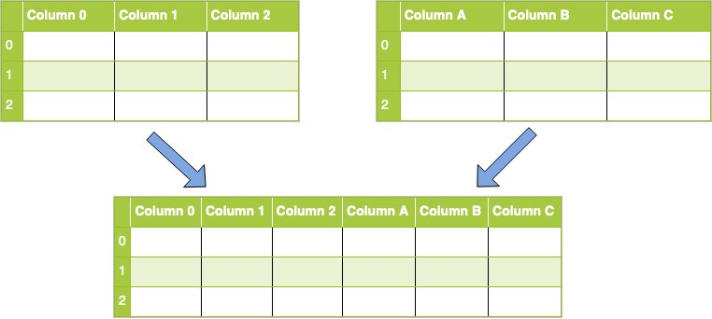
When would you use .merge(), .join(), or .concat()?
.merge() you would most often use to merge two dataframes, as it is the most efficient and has the most parameterization to get the fit of what you want. .join() you would use for a simple join operation along a pre-specified index column. By default, it does a left join, but you can specify with the on parameter too.
.concat() you would use when you want to concatenate the rows of one dataframe to another (they have the same number of columns) or you want to concatenate the columns of one dataframe to another (they have the same number of rows, but have supplemental information for each row that can be captured in a larger table).

Slide 33
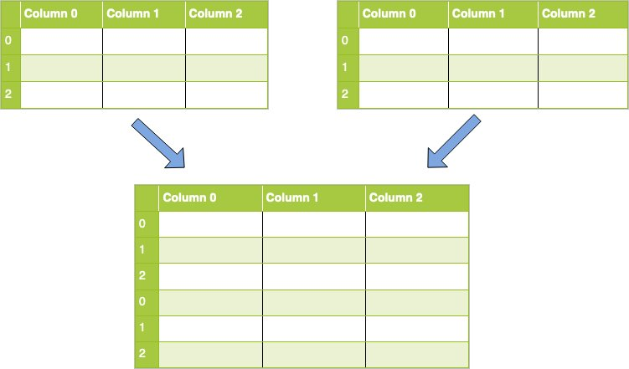
What kind of concat() is this?

Slide 34
What kind of concat() is this?
Row concatenation.

Slide 35
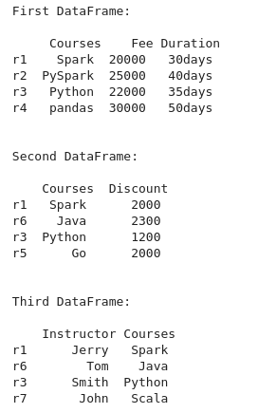
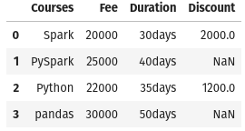
Given the dataframes on the left and df1 is our left dataframe what kind of merge do we perform to get the right table?

Slide 36
Given the dataframes on the left and df1 is our left dataframe what kind of merge do we perform to get the right table?
Left join!

Slide 37
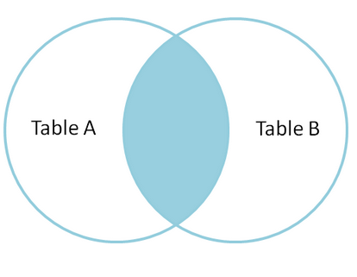
Given the following diagram, what type of join are we looking at?

Slide 38
Given the following diagram, what type of join are we looking at?
Inner join.

